Slide 1

HTTP vs HTTPS: Wireshark & Simulation-Based Comparison
Wireshark • Cisco Packet Tracer • Python HTTPS Server Demo
Ahmed Moataz 22-101092
Ismail Taher 21-101013

Slide 2
SECTIONS OVERVIEW
Introduction & Objectives
HTTP vs HTTPS Theory
TLS Deep Dive
MTU & Performance
Wireshark Demos
Packet Tracer Simulation
Local Server Demo
Final Takeaways
Bonus Slides 🎉

Slide 3

#01
Introduction + Objectives

Slide 4
Project Goals
Explain the difference between HTTP & HTTPS
Show how data is transmitted in both protocols
Use real tools to visualize security in action
Highlight vulnerabilities & mitigation strategies

Slide 5
Tools Used
Wireshark: Network packet analysis
Cisco Packet Tracer: Simulated topologies
Python Local Server: Demo HTTPS traffic
OpenSSL: Generate SSL/TLS certificates

Slide 6

#02
HTTP vs HTTPS Theory

Slide 7
What is HTTP?
Stands for HyperText Transfer Protocol
Used to transfer web content
Simple, fast… but insecure
Sends all data in plain text 🚫

Slide 8
What is HTTPS?
Adds “Secure” to HTTP: HTTP over TLS
Uses encryption to protect data
Uses certificates to prove server identity
Now the default standard for secure websites

Slide 9


HTTP vs HTTPS
HTTP
HTTPS
No Encryption
Port 80
Does not authenticate server
Visible to eavesdroppers
Can be used for blogs and/or static content
Uses TLS encryption
Port 443
Authenticates server
Not visible to eavesdroppers (traffic is encrypted)
Is a MUST for logins, payments and user data

Slide 10

HTTP vs HTTPS explained (with a fun meme)

Slide 11

#03
A Deep Dive Into TLS

Slide 12
TLS vs SSL
SSL: Older, deprecated (use of SSL is a red flag 🚩)
TLS: Modern and secure
TLS 1.2: Widespread
TLS 1.3: Improved performance and security

Slide 13
TLS 1.3 Highlights
One round-trip handshake (faster)
Removes insecure algorithms (like RSA key exchange)
Prevents downgrade attacks
Shorter connection setup time = better user experience

Slide 14
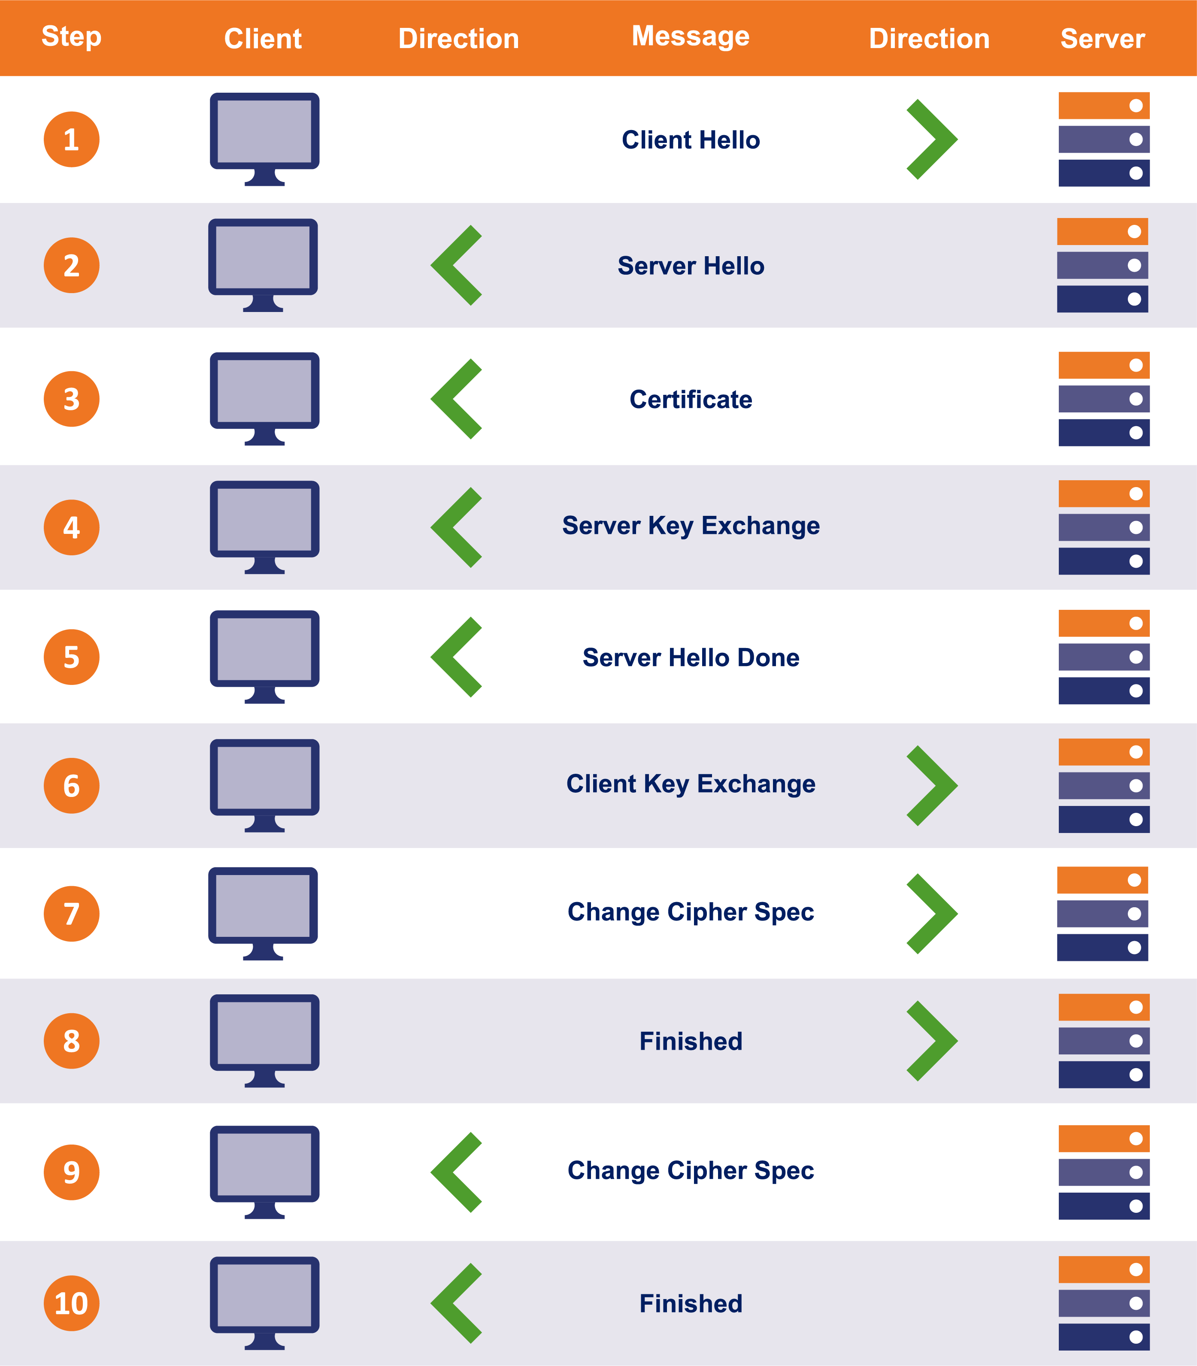
TLS Handshake Steps
ClientHello
ServerHello + Certificate
Key Exchange
Session Key Derived
Secure Communication Begins
🧠 Only the handshake uses asymmetric encryption ➡️ Data uses fast symmetric encryption after setup

Slide 15
TLS Security Benefits
Confidentiality: Data is private
Integrity: Tampering is detectable
Authentication: Server identity is validated

Slide 16

#04
MTU, Segmentation & Performance
This Photo by Unknown Author is licensed under CC BY

Slide 17
What is MTU?
Maximum Transmission Unit = max packet size (usually 1500 bytes)
Large packets must be split if they exceed this

Slide 18
Why does MTU matter for HTTPS?
TLS adds encryption overhead → larger packets
Can cause:
IP fragmentation
TCP segmentation
ICMP errors (if “Don’t Fragment” flag is set)

Slide 19
Real-World MTU Issues
Misconfigured routers can block large encrypted packets
TLS handshakes may fail if MTU isn't handled
Solutions:
Path MTU Discovery
Tuning application payload sizes

Slide 20
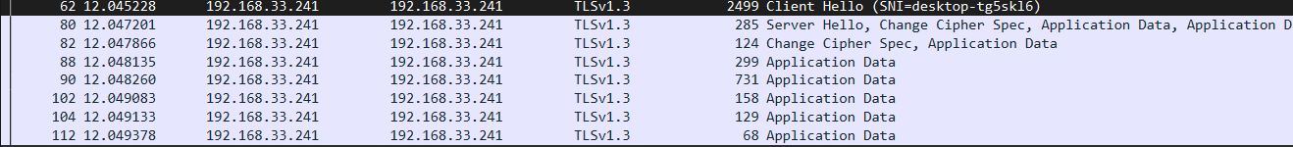
#05
WireShark Anaylsis

Slide 21
Demo Setup
Simple Python web server
HTML login form (username + password)
Packet capture in Wireshark

Slide 22
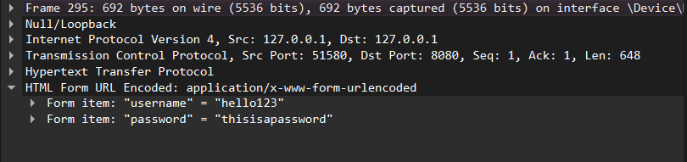
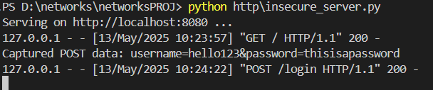
HTTP in Wireshark
Captured POST data is visible in plain text
Shows full username= and password= values
Proves lack of encryption

Slide 23
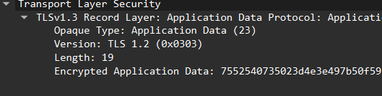
HTTPS in Wireshark
Shows TLS handshake
Data appears as Encrypted Application Data
Credentials not visible

Slide 24
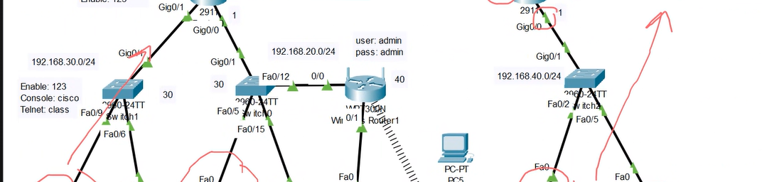
#06
Cisco Packet Tracer Demo

Slide 25
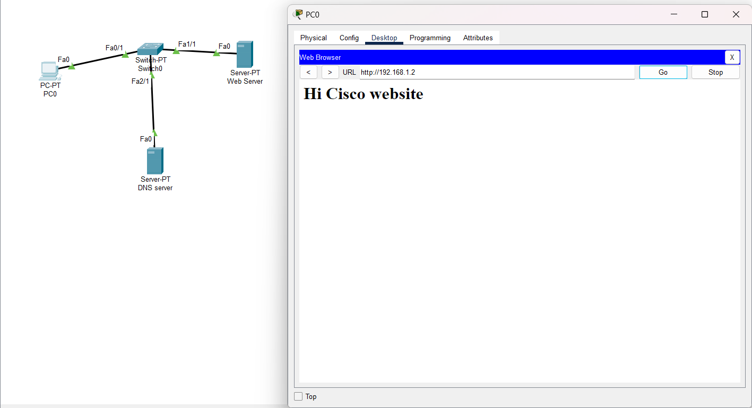
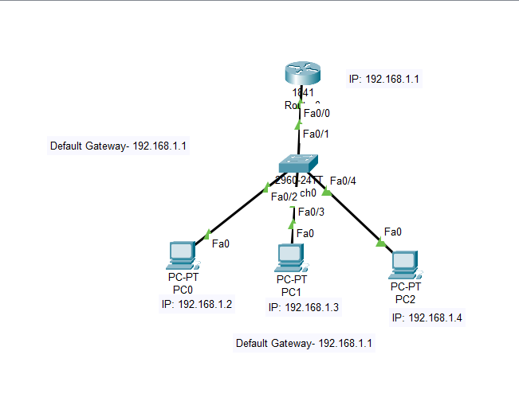
Implementations
HTTPS Setup
(port 443)
HTTP Server Implemenation
(port 80)

Slide 26
Packet Tracer Limitations
Doesn’t simulate real TLS encryption
Symbolic only — good for conceptual learning
Still shows port differences + DNS resolution

Slide 27

#07
Local Server Demo

Slide 28
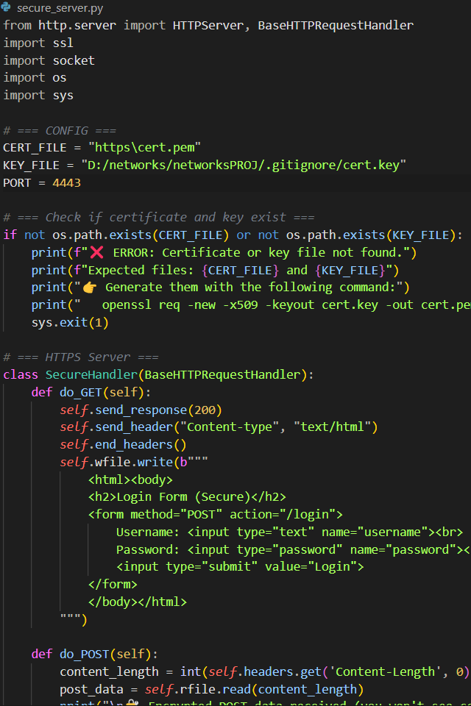
HTTPS Server Setup
Generate certificate using openssl
Start secure_server.py with HTTPS config
Open in browser: https://localhost:4443
Capture traffic in Wireshark

Slide 29
What We Learned
Even with a self-signed cert, HTTPS encrypts traffic
Wireshark shows TLS handshake + encrypted payload
Validates protection of data end-to-end

Slide 30

#08
Conclusion + Takeaways

Slide 31
Summary of Key Points
HTTP is insecure: credentials exposed, no encryption
HTTPS is secure: TLS encrypts and authenticates
Wireshark shows the stark difference
Always use HTTPS for anything sensitive

Slide 32
Final Notes & References
Wireshark documentation
TLS 1.3 RFC
Python HTTP/HTTPS docs
Packet Tracer curriculum
GitHub Repo

Slide 33

#09
Bonus Slides???

Slide 34
DID YOU KNOW???
💥 Google marks HTTP-only sites as "Not Secure"
🔍 Over 90% of traffic on Chrome is now HTTPS
🧠 TLS 1.3 can be 30% faster than TLS 1.2
📵 Some public Wi-Fi providers inject ads into HTTP pages

Slide 35
DID YOU KNOW???
🧠The “S” in HTTPS doesn’t stand for “Secure” — it’s just “HTTP + SSL/TLS” … but everyone says it means “secure,” and honestly? Fair.
🐍 Python's built-in HTTP server literally sends everything in plaintext — so your password? Yeah, it’s street art now.
🛑If you use public Wi-Fi and visit an HTTP site, your login credentials can be seen by that one dude in the hoodie at Starbucks.

Slide 36
DID YOU KNOW???
💡 Hackers don’t need to “hack” HTTP traffic — they just look at it.
😬 Your ISP can inject ads, block content, or track everything you do — if you’re using HTTP.
🎤 Firesheep, a Firefox extension from 2010, let users hijack Facebook sessions on coffee shop Wi-Fi in two clicks. That’s wild.

Slide 37
Scary Stuff We’ve Actually Seen
🧟‍♂️ Firesheep (2010)
Let anyone on public Wi-Fi hijack your Facebook session. Like… click → boom → you’re Mark Zuckerberg now.
💔 Heartbleed (2014)
Bug in OpenSSL let attackers read server memory, including private keys & TLS secrets. Millions affected.
🎯 NSA/PRISM Leaks
Revealed massive government surveillance using unencrypted web traffic.
HTTPS? Not optional anymore.
📦 ISPs Injecting Ads
Real providers modified HTTP pages to show their own ads without asking.
Try that with HTTPS. (They can’t.)
🕵️‍♂️ Wi-Fi Pineapples
Cheap hardware tools that trick your phone/laptop into thinking it’s a “known” network — then sniff all your HTTP data.

Slide 38
QUIZ TIME!!!

Slide 39
Which of the following is TRUE?
A) HTTP uses port 443
B) HTTPS always uses SSL
C) TLS handshake uses symmetric encryption
D) HTTPS protects against MITM attacks

Slide 40
Which of the following is TRUE?
A) HTTP uses port 443
B) HTTPS always uses SSL
C) TLS handshake uses symmetric encryption
D) HTTPS protects against MITM attacks

Slide 41
What does TLS stand for?
A) Transport Level Security B) Transmission Layer Standard C) Transport Layer Security D) Transfer Link Standard

Slide 42
What does TLS stand for?
A) Transport Level Security B) Transmission Layer Standard C) Transport Layer Security D) Transfer Link Standard

Slide 43
Why is SSL no longer recommended?
A) It’s too fast B) It causes DNS issues C) It lacks encryption D) It has known vulnerabilities

Slide 44
Why is SSL no longer recommended?
A) It’s too fast B) It causes DNS issues C) It lacks encryption D) It has known vulnerabilities

Slide 45
QUESTIONS?
Let’s chat!!

Slide 46
THANK YOU
Always use HTTPS.
Stay secure out there.

